Slide 1
Synthetic Sensor Data Generation for Mental Health Human Computer Interaction
Department of Computer Science and Engineering
TEAM
Abhishek Singh Maurya
Devara Bhavana Sri Harshitha
Telugu Tharun Kumar
Rahul Kumar Verma
Suyash Chitransh
Professor - Bivas Mitra
Mentor - Tarannum Ara

Slide 2
Basic Outline
01
02
03
04
05
06
Introduction
Datasets
Model
Problem Statement, Motivation, Challenges, and Contribution.
What datasets are we using?
What Models did we use?
Results
Demo
Conclusion
What did we find?
A showcase of our work
Final words

Slide 3
01
Introduction
Problem Statement, Motivation, Challenges, Contribution

Slide 4
Why Synthetic Data?
The issues with Real-world Datasets are:
1
Limited
Real-world datasets are often small, imbalanced, or incomplete.
Hard to collect large, diverse samples across conditions.
2
Costly
Data collection and labeling require time, expertise, and resources.
In sensitive domains (e.g., healthcare, finance), data is restricted or expensive.
3
Private
Real data often contains confidential or personal information.
Raises privacy, compliance, and sharing issues.
Hence, we turn to synthetic data- a scalable, privacy-safe alternative for training AI models.

Slide 5
What makes Time-Series generation hard?
Challenges
Motivation
1
Temporal Complexity
Difficult to capture long-term dependencies and cross-modal correlations.
Need a robust framework that can:
Preserve temporal coherence
Handle multiple modalities
Maintain training stability
MODEL INSTABILITY
2
Generative models often face mode collapse and unstable training dynamics.
3
EVALUATION DIFFICULTY
Lack of standard metrics makes assessing realism and diversity subjective.

Slide 6
Our Contributions
Member | Contribution
Abhishek Singh Maurya
Devara Bhavana Sri Harshitha | Developed a reusable workflow for synthetic data generation using WESAD (BVP). Evaluated quality via downstream classification tasks.
Telugu Tharun Kumar | Worked on the swell dataset part
Rahul Kumar Verma | Designed and implemented the end-to-end synthetic data generation pipeline using a Wasserstein GAN with Gradient Penalty (WGAN-GP) for in-house project and Lifesnaps dataset Validated synthetic data quality using statistical similarity metrics such as Wasserstein distance
Suyash Chitransh | Assisted in design and implementation of pipeline for in-house project and Lifesnaps dataset

Slide 7
02
Datasets
What datasets are we using?

Slide 8
Datasets used in our work
Lifesnaps
SWELL
In-House Data
Real-world wearable signals: EDA, HRV, ACC
Workplace stress dataset
Signals: EDA, HR, TEMP, ACC
Signals: ECG, GSR, BVP
EDA (Electrodermal Activity) - 0.01–60 µS (higher values indicate higher arousal or stress.)
HR / HRV (Heart Rate / Heart Rate Variability) - HR: 50–120 bpm, HRV: 20–200 ms (captures heartbeat rate and variability.)
TEMP (Skin Temperature) - 30–37 °C (generally stable; slightly decreases during stress.)
ACC (Accelerometer – 3 axis) - 2g to +2g (or ±8g) (measures body movement; 1g ≈ 9.81 m/s².)
Also explored earlier: WESAD and DAPPER datasets for baseline experiments.
Notes:
Inhouse dataset
time – Time or timestamp of each sample (used to align data).
ECG – Electrocardiogram signal showing heart electrical activity.
BVP – Blood Volume Pulse, shows blood flow from PPG sensor.
GSR – Galvanic Skin Response, measures skin conductance changes (stress/arousal).
Resp – Respiration or breathing rate pattern.
Skin_Temp – Skin temperature; drops during stress, rises during relaxation.
EMG_z – EMG signal from zygomatic (cheek) muscle, linked with smiling.
EMG_c – EMG signal from corrugator (brow) muscle, linked with frowning.
EMG_t – EMG signal from trapezius (shoulder/neck) muscle, related to tension.
valence – Emotional positivity or negativity (pleasant vs unpleasant).
arousal – Emotional intensity or activation (calm vs excited).
Lifesnaps dataset
id – Unique identifier for each user or record.
nightly_temperature – Average body or skin temperature recorded during sleep.
nremhr – Heart rate during non-REM sleep.
rmssd – Root Mean Square of Successive Differences in heartbeats (heart rate variability measure).
spo2 – Blood oxygen saturation percentage.
full_sleep_breathing_rate – Average breathing rate during full sleep.
stress_score – Computed physiological stress level score.
sleep_points_percentage – Percentage of sleep quality points achieved.
exertion_points_percentage – Daily exertion (physical effort) points percentage.
responsiveness_points_percentage – Recovery or responsiveness points percentage.
daily_temperature_variation – Change in body temperature throughout the day.
calories – Total calories burned.
filtereddemographicvo2max – Estimated VO₂ max (aerobic fitness metric) adjusted by demographics.
distance – Distance covered (e.g., walking/running).
bpm – Average heart rate in beats per minute.
lightly_active_minutes – Minutes spent doing light activity.
moderately_active_minutes – Minutes spent in moderate activity.
very_active_minutes – Minutes spent in vigorous activity.
sedentary_minutes – Minutes spent sitting or inactive.
mindfulness_session – Number or duration of mindfulness/meditation sessions.
scl_avg – Average skin conductance level (stress indicator).
resting_hr – Resting heart rate.
sleep_duration – Total sleep duration.
minutestofallasleep – Minutes it took to fall asleep.
minutesasleep – Total minutes actually asleep.
minutesawake – Minutes awake during the night.
minutesafterwakeup – Minutes spent in bed after waking up.
sleep_efficiency – Ratio of sleep time to time in bed (sleep quality).
sleep_deep_ratio – Proportion of deep sleep.
sleep_wake_ratio – Proportion of time awake during sleep period.
sleep_light_ratio – Proportion of light sleep.
sleep_rem_ratio – Proportion of REM sleep.
steps – Total steps taken.
minutes_in_default_zone_1 – Minutes spent in heart-rate zone 1 (low effort).
minutes_below_default_zone_1 – Minutes below zone 1 (resting).
minutes_in_default_zone_2 – Minutes in heart-rate zone 2 (moderate effort).
minutes_in_default_zone_3 – Minutes in heart-rate zone 3 (high effort).
age – Age of the user.
gender – Gender (e.g., 0 = male, 1 = female).
bmi – Body Mass Index.
step_goal – Daily step goal.
min_goal – Minimum activity or sleep goal.
max_goal – Maximum activity or sleep goal.
alert – User’s self-reported emotion: alert.
happy – Emotion: happiness level.
neutral – Emotion: neutral state.
rested/relaxed – Emotion: rested or relaxed level.
sad – Emotion: sadness level.
tense/anxious – Emotion: tension or anxiety level.
tired – Emotion: tiredness level.
entertainment – Context tag: engaging in entertainment.
gym – Context tag: in gym/physical activity.
home – Context tag: at home.
home_office – Context tag: working from home.
other – Context tag: other location/activity.
outdoors – Context tag: outside environment.
transit – Context tag: in transit/traveling.
work/school – Context tag: at workplace or school.
user_id – Redundant or alternative identifier for user.
stai_stress – Stress score from State-Trait Anxiety Inventory.
stress_level_3class – Categorized stress level (e.g., low, medium, high).
stress_level_2class – Binary stress class (e.g., stressed vs not stressed).

Slide 9
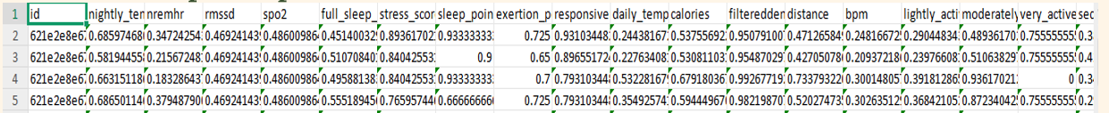
LifeSnaps Original dataset
LifeSnaps Synthetic dataset
2,965 entries
17,041 entries

Slide 10
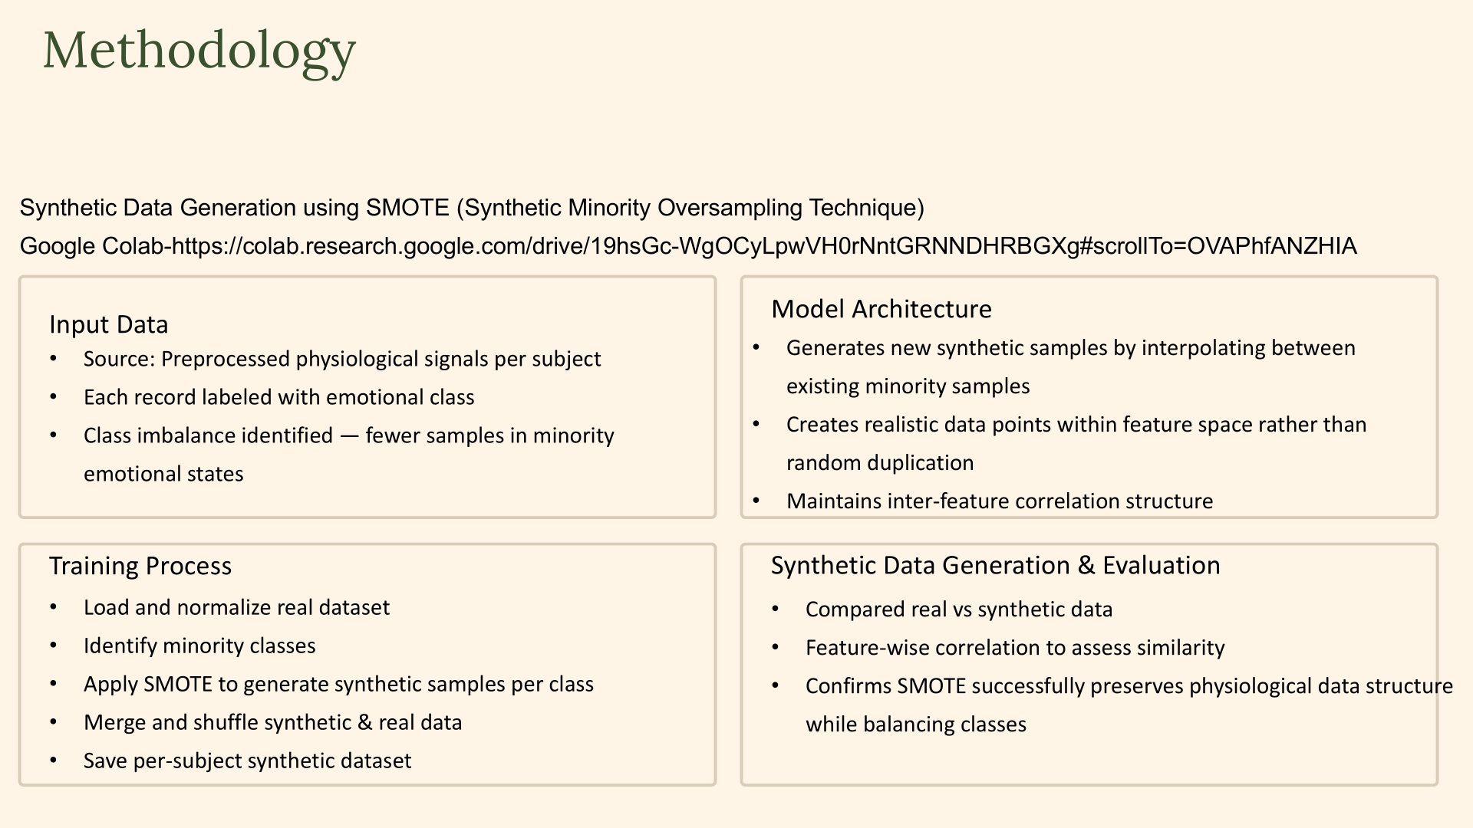
: Synthetic Data from Lifesnaps dataset

Slide 11
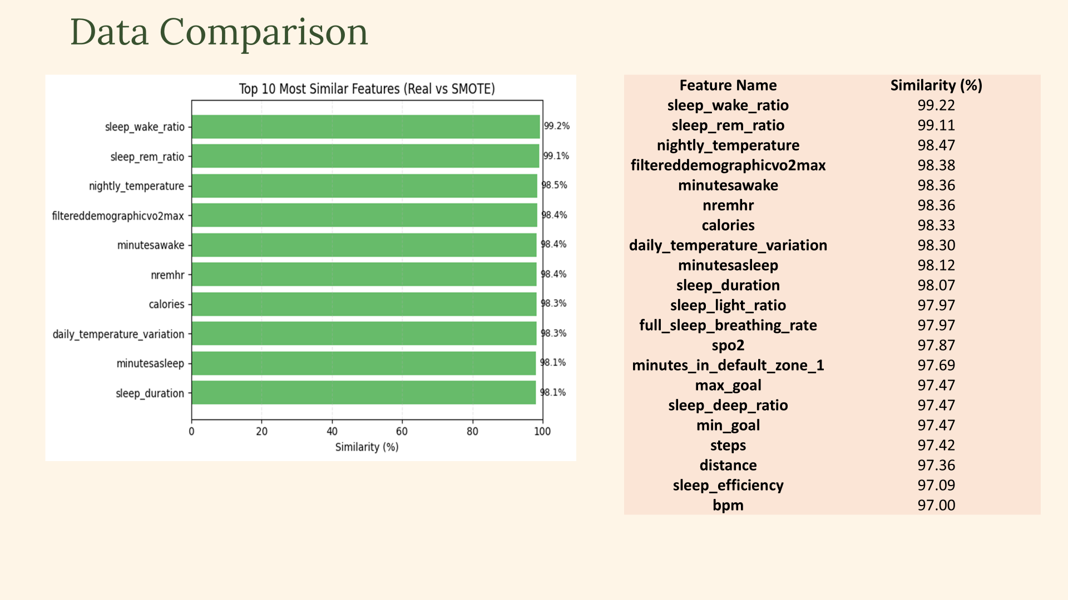
: Original vs Synthetic Lifesnaps data

Slide 12
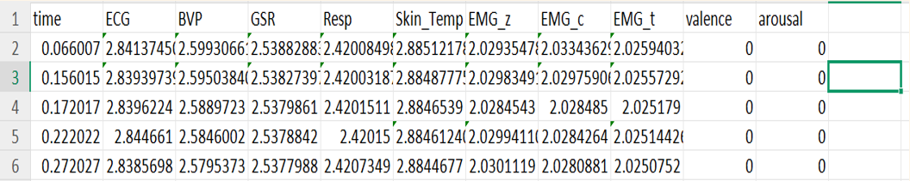
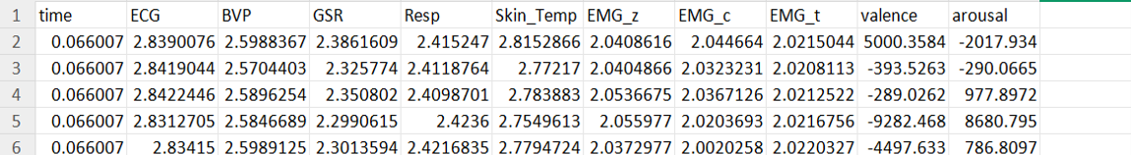
In-House Original dataset
In-House Synthetic dataset
49,011 entries
2,45,051 entries

Slide 13
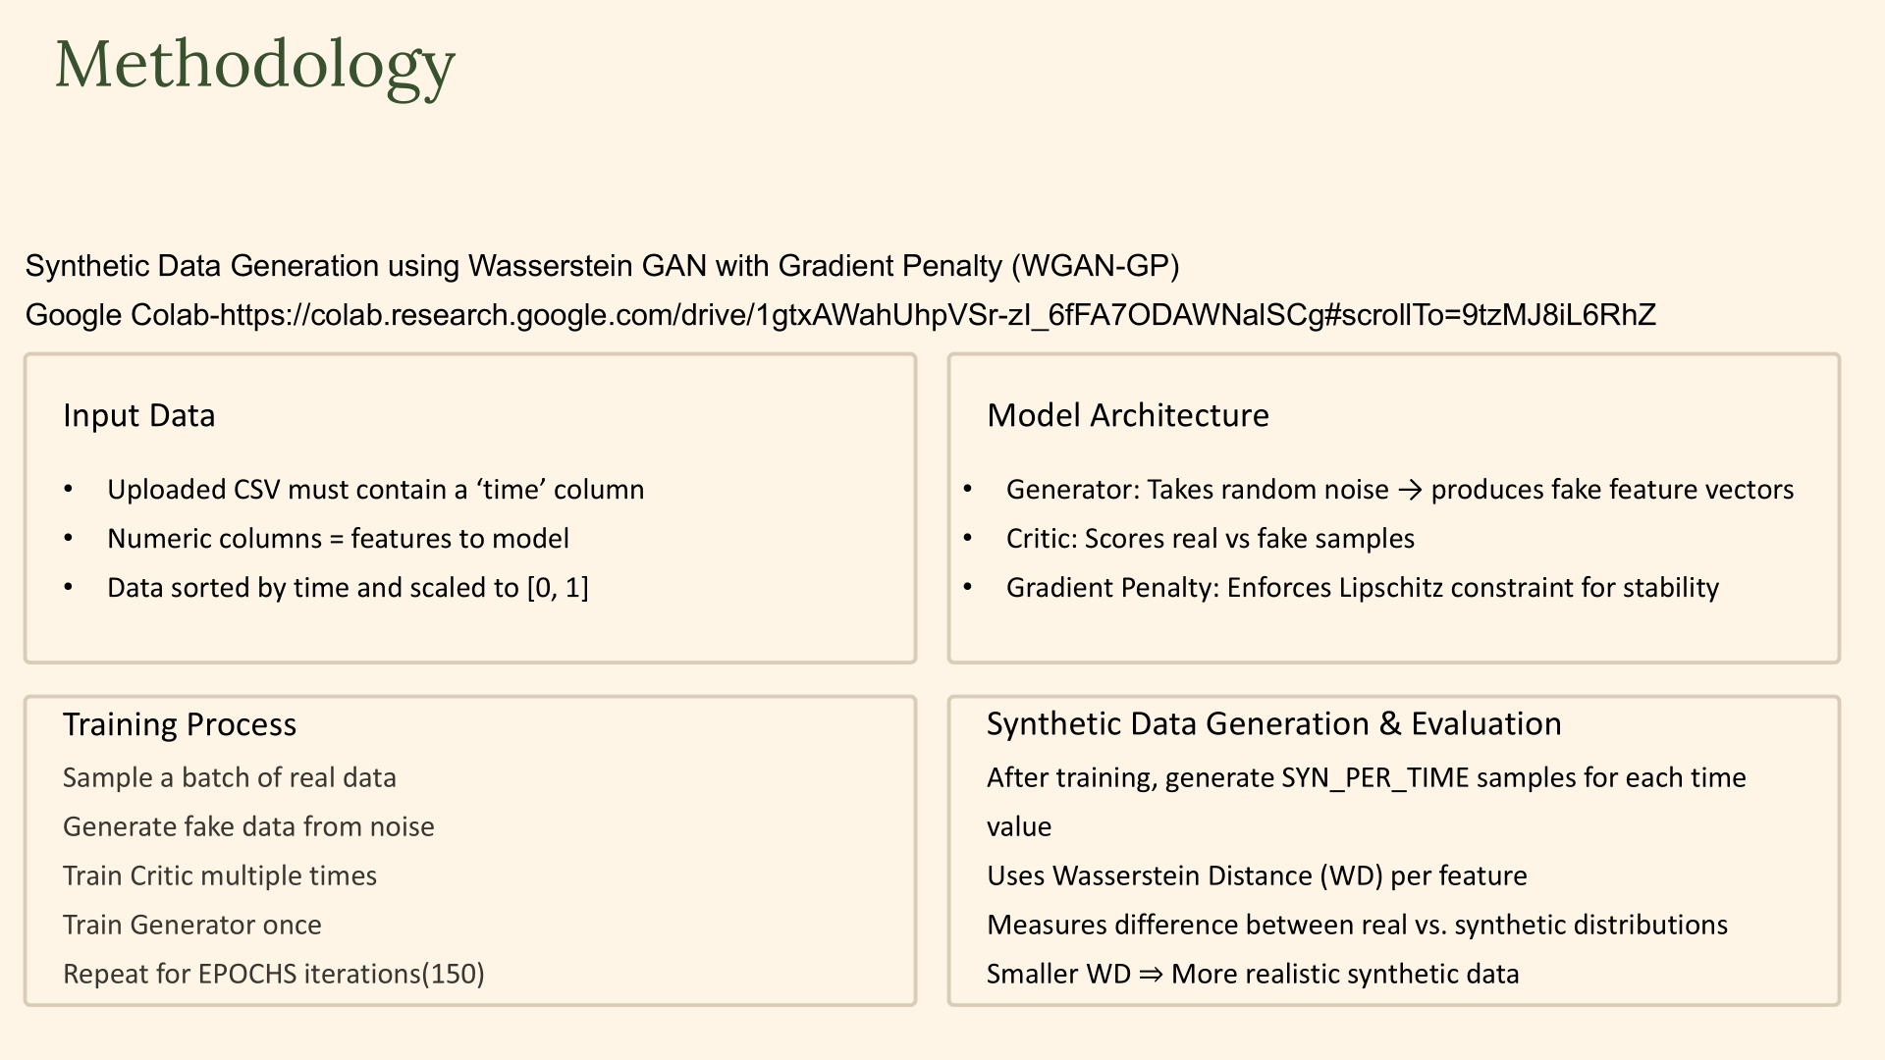
: Synthetic Data from In-house dataset

Slide 14
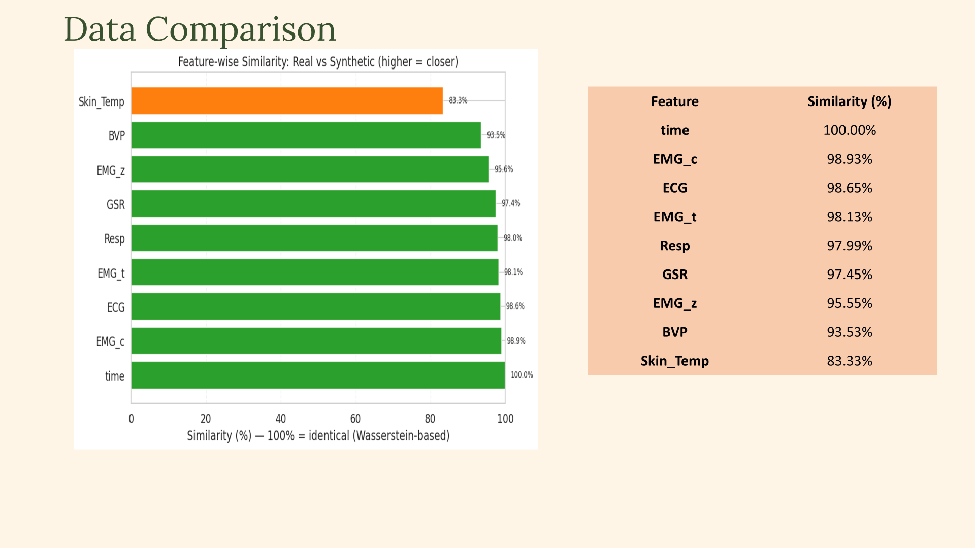
: Original vs Synthetic In-House data

Slide 15
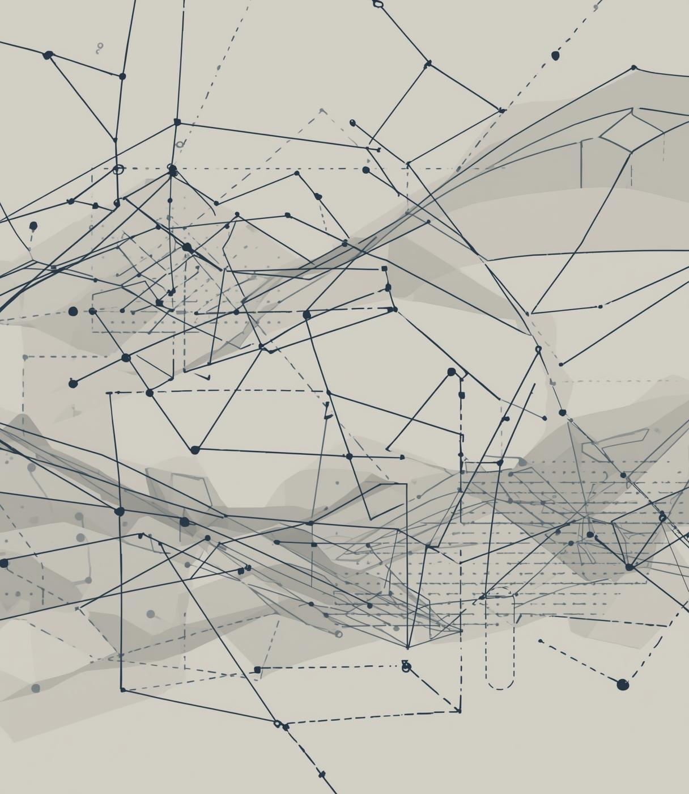

SWELL
Synthetic Data Generation using SWELL
PRESENTED BY
TELUGU THARUN KUMAR

Slide 16

SWELL Dataset Overview
The SWELL HRV dataset, sourced from Kaggle, segments 10-minute windows of heart rate variability, encompassing critical metrics for stress analysis and subsequent modelling processes.
We explored the SWELL dataset, measuring physiological responses to common workplace stressors.Our focus was on Heart Rate Variability (HRV), a key indicator of stress levels.
CONDITIONS USED:
1)No Stress
2)Time Pressure
3)Interruption

Slide 17
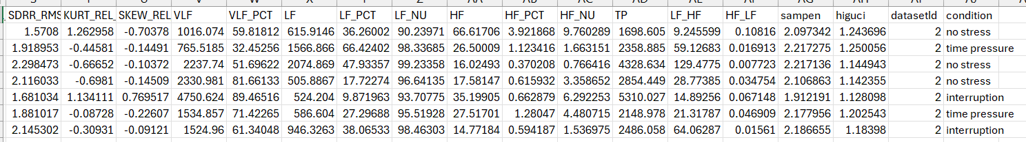
SWELL Original dataset
SWELL Synthetic dataset
369,289 entries
Generated 73,854 sequences, i.e 24618 for each condition

Slide 18
03
Model
The models used for Synthetic Data Generation.

Slide 19
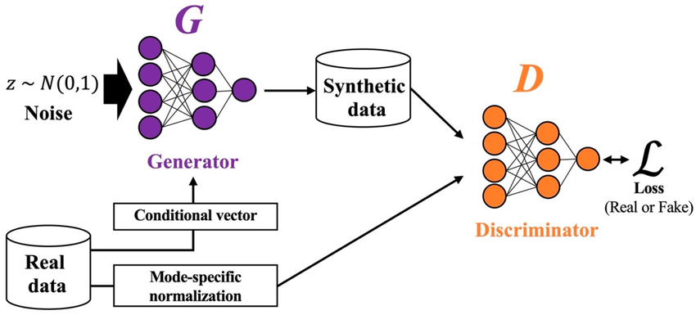
CTGAN
CTGAN is essential for synthetic HRV signal generation, effectively handling mixed-type data and imbalances while preserving the critical stress-related patterns inherent in HRV metrics.

Slide 20
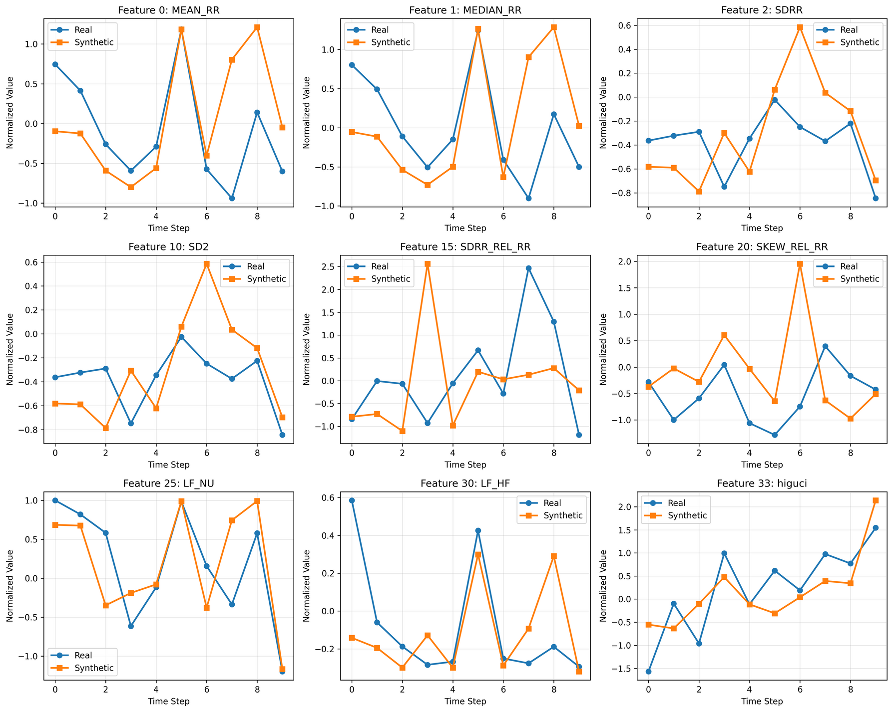
Synthetic vs Real Comparison
This section highlights the similarities between synthetic and real HRV data, demonstrating that our CTGAN-generated sequences effectively replicate the characteristics of genuine human heart rate variability.

Slide 21
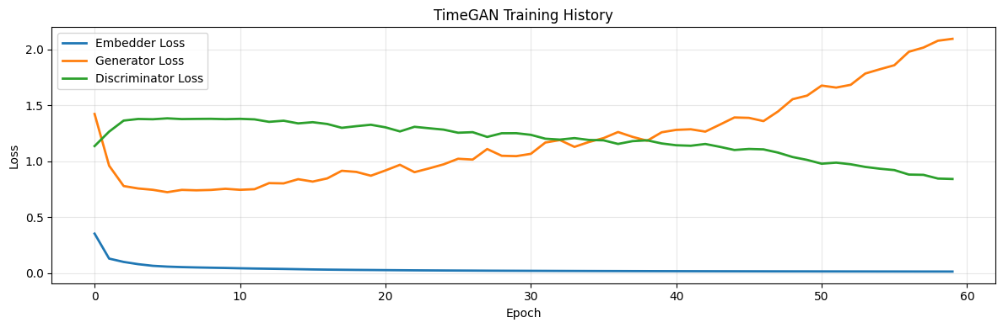
The CTGAN approach effectively preserved HRV stress patterns, validating the high-quality synthetic data generated, which enables privacy-preserving modeling and scalable augmentation for future research.
“Training loss trends showing stable adversarial convergence — embedder stabilizes early, while generator and discriminator maintain balanced learning.”

Slide 22
04
Results
Our findings!

Slide 23
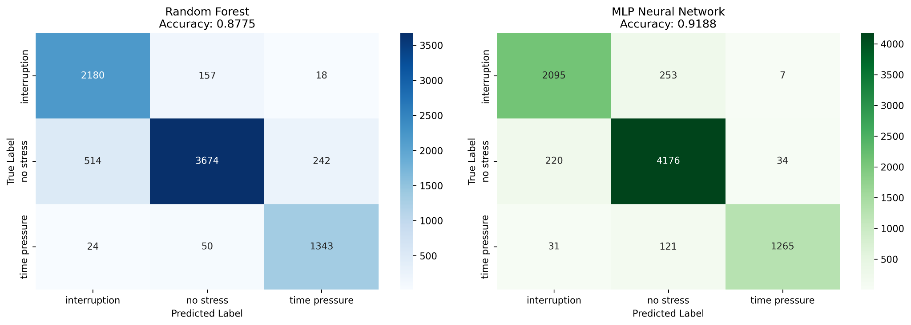

Evaluation Metrics
Accuracy
Model |  | F1-Score
Random Forest (Synthetic) | 0.877 | 0.878
MLP (Synthetic) | 0.918 | 0.918
Random Forest (Real - Baseline) | 0.966 | 0.966

Slide 24
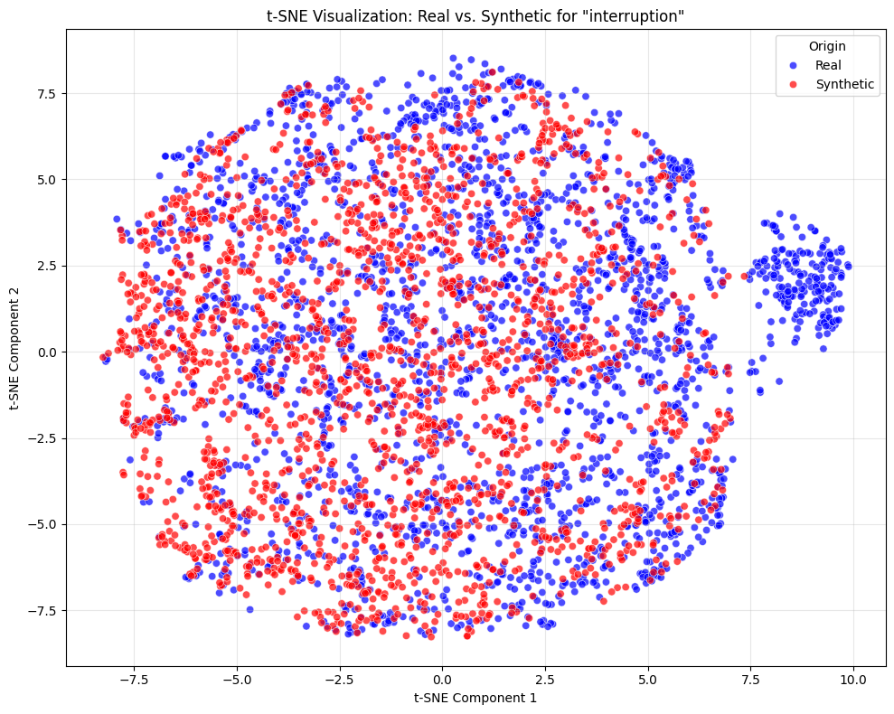
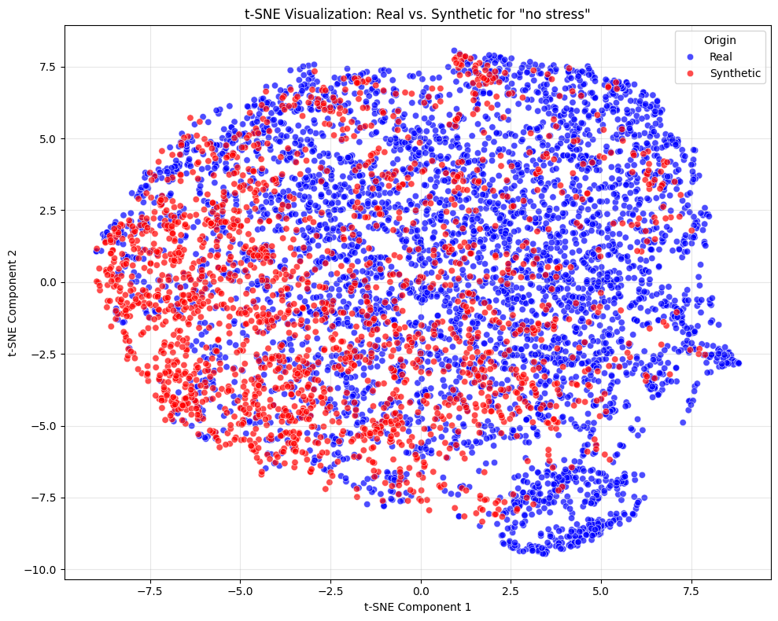
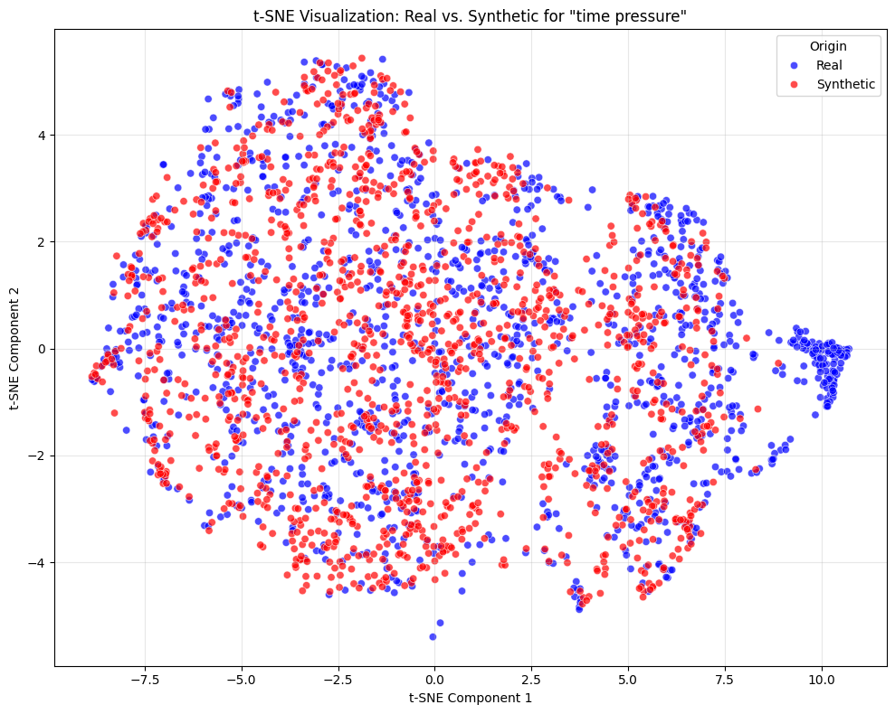

Slide 25
05
Demo
A brief showcase of our work.

Slide 26
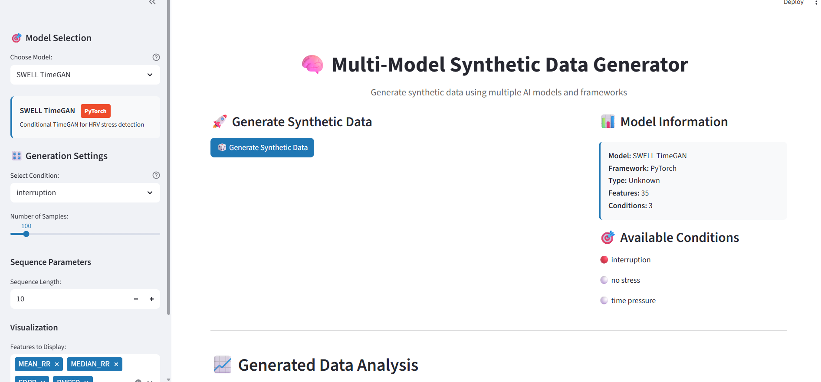
MULTI MODEL DASHBOARD

Slide 27
06 Conclusion
We addressed the challenge of limited and privacy-sensitive real-world datasets by exploring synthetic data generation.
Implemented a GAN-based framework to generate realistic multimodal time-series data (EDA, HRV, TEMP, ACC).
Achieved stable training, improved temporal consistency, and maintained cross-modal correlations.
Validated the generated data using downstream classification tasks, showing its usefulness and quality.
Demonstrated that synthetic data can serve as a scalable, privacy-safe alternative for real-world physiological data modeling.

Slide 28
Thank you!

